Slide 1

Juvenile Expunction: Myths and Facts
Office of the Juvenile defender
2015

Slide 2
Juvenile Expunction: Introduction
Why expunction?
How NC fares nationally
Expunction v. confidentiality v. sealing
Details of eligibility
Impact on adult expunctions
Tools and resources

Slide 3
Juvenile Expunction: What’s the Deal?
Juvenile expunctions available for a number of offenses
Very few expunctions currently happening
Might be misconceptions
Juvenile record increasingly accessible; more collateral consequences

Slide 4
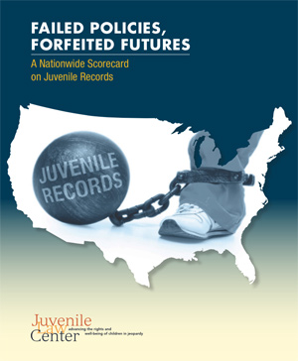
Juvenile Expunction: NC v. USA
Expungements available
Records eligible for expungement
Expungement not automatic
Youth not notified of expungement*

Slide 5
Juvenile Expunction: v. Confidentiality and Sealing
Confidentiality, NCGS 7B-3000 and -3001:
  The limiting of access to juvenile records, including NCJOIN, JWise, and police records
  Can be available to certain parties, and under certain circumstances
  Can be obtained by order of the court
  Court hearings are open unless closed
Sealed records, NCGS 7B-3000(c):
  Must be directed by the court
  Sealed and marked in an envelope
  Examination or copying only by specific order of the court

Slide 6
Juvenile Expunction: Details - Dismissed
May apply at 16
Any offense
Petition filed
Chief court counselor is notified and may object
If no objection, expunction granted without a hearing

Slide 7
Juvenile Expunction: Details - Adjudicated
May apply at 18
At least 18 months have elapsed since the person was released from juvenile court jurisdiction, and the person has not subsequently been adjudicated delinquent or convicted as an adult of any felony or misdemeanor other than a traffic violation under the laws of the United States or the laws of this State or any other state
The offense for which the person was adjudicated would have been a crime other than a Class A, B1, B2, C, D, or E felony if committed by an adult
Petitions/affidavits
District attorney has the opportunity to object
Expunction granted after hearing

Slide 8
Juvenile Expunction: What Is Expunged?
The court shall order:
  the clerk and
  the appropriate law enforcement agencies to expunge their records of the allegations of delinquent acts including all references to
    arrests,
    complaints,
    referrals,
    juvenile petitions, and
    orders
  The clerk shall forward a certified copy of the order of expunction to the sheriff, chief of police, or other appropriate law enforcement agency, and to the chief court counselor, and these specified officials shall immediately destroy all records relating to the allegations that the juvenile was delinquent

Slide 9
Juvenile Expunction:
Affects Adult Expunction?
NOT an automatic bar to applying for or receiving an adult expunction
  No mention of juvenile expunction in 15A
However, it may be reported to a superior court judge:
  clerk is mandated to file with the Administrative Office of the Courts (AOC) names of persons who are granted an expunction and this information “shall be disclosed only to judges of the General Court of Justice of North Carolina for the purpose of ascertaining whether any person charged with an offense has been previously granted an expunction”
  AOC, upon the request of a superior court judge, releases the names of persons who have received an expunction, adult or juvenile
Importance of effective communication with client:
  Discuss options in developmentally appropriate way
  Discuss resources

Slide 10
Juvenile Expunction: Impacts - Court
NCGS 7B-3000(e): for an individual less than 21 at the time of the offense committed, the court system may consider A1 misdemeanors and any felony since age 13 in determining pretrial release, plea negotiation decisions and plea acceptance decisions
NCGS 7B-3000(e1): an adult probation officer may review the record of a juvenile adjudication of a felony for a person under 25 under adult supervision “for the purpose of assessing risk related to supervision”
After a dismissal, expunction would benefit a juvenile if he/she had further contact with law enforcement, since frequently law enforcement use contacts with the criminal or juvenile justice systems as a factor in determining whether to detain, arrest, or otherwise process someone

Slide 11
Juvenile Expunction: Impacts - School
NCGS 7B-3101(a)(3): the court counselor is to notify the school of attendance if a felony allegation is dismissed
  No reference to notify the school of expunction, however, under 115C-404, Use of juvenile court information, “the principal shall shred, burn, or otherwise destroy documents received in accordance with G.S. 7B-3100 to protect the confidentiality of the information when the principal receives notification that…the court granted the student’s petition for expunction of the records”
May have an impact on student assignment to classes or activities, or whether disciplinary actions should be taken in situations that arise
Note: since “other appropriate law enforcement officer” is listed under 7B-3200, this should include SROs and likewise impact their decisions

Slide 12
Juvenile Expunction: Impacts - Collateral
Job applications
Educational application
Educational assistance applications
Military applications
Housing

Slide 13
Juvenile Expunction: H879
SECTION 2.5. G.S. 7B-2512 reads as rewritten:
"§ 7B-2512. Dispositional order.
***
(b) The court shall include information at the time of issuing the dispositional order,
either orally in court or in writing, on the expunction of juvenile records as provided for in
G.S. 7B-3200 that are applicable to the dispositional order."

Slide 14
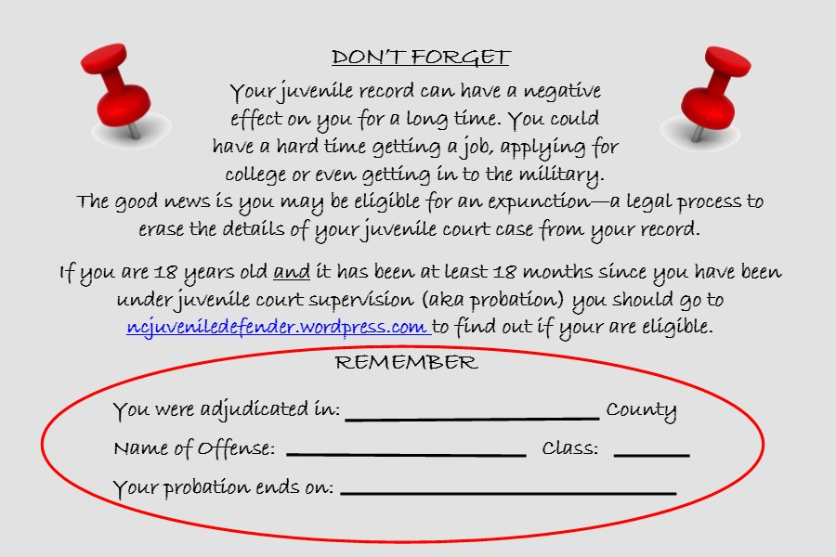
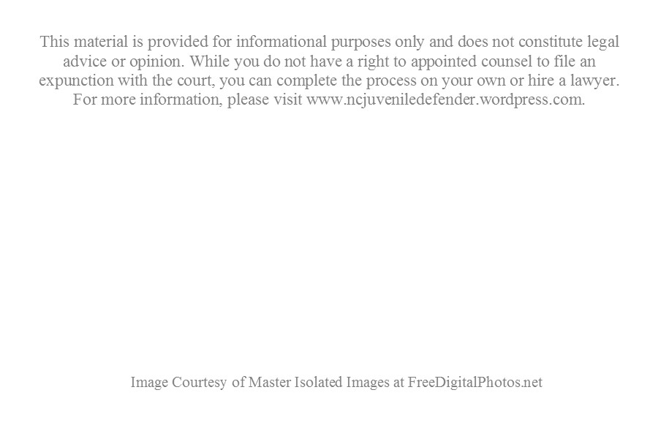
Juvenile Expunction: Notice Card

Slide 15
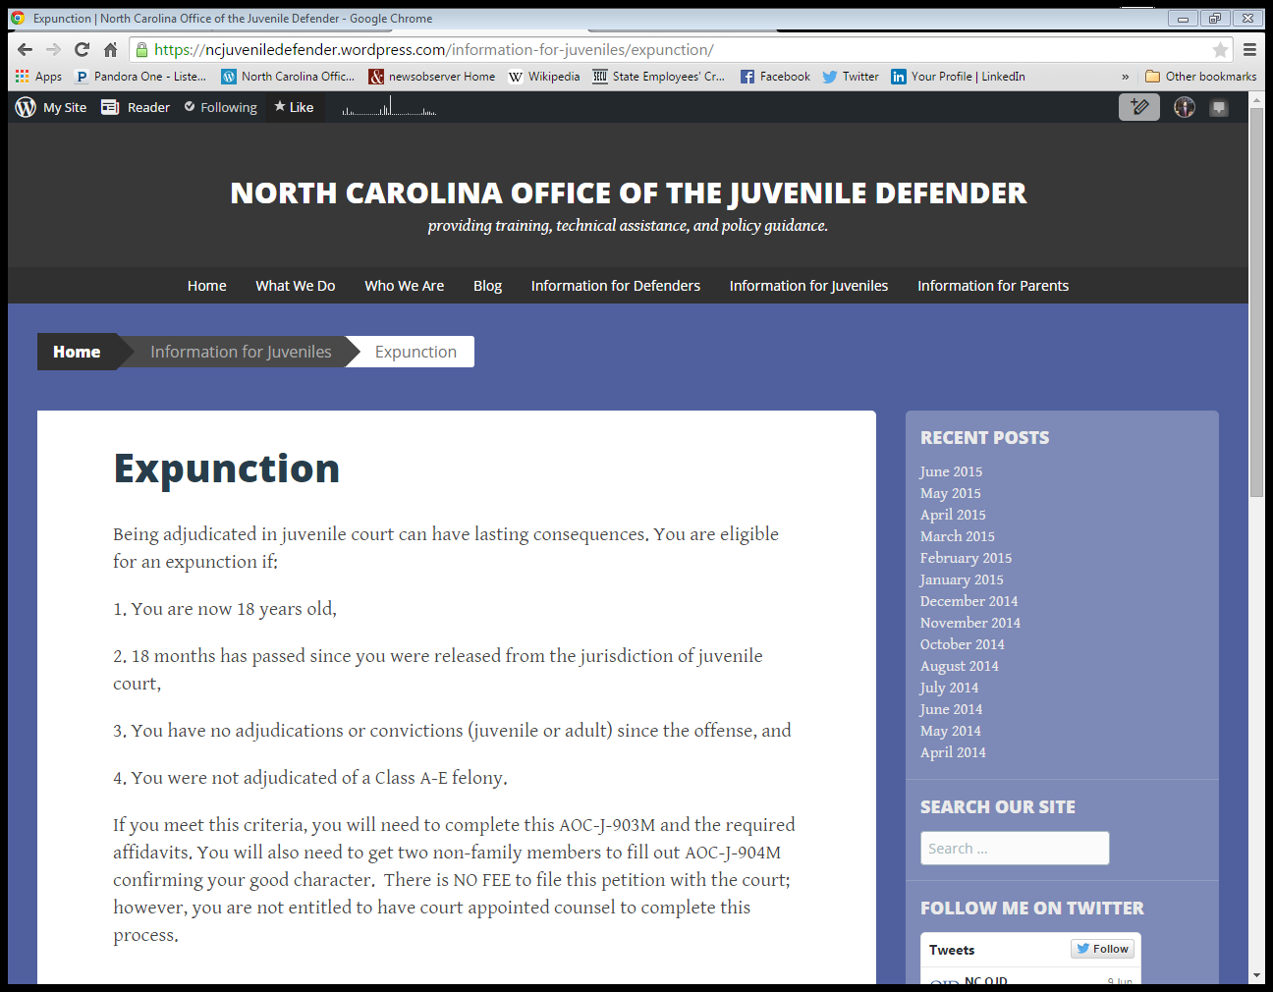
Juvenile Expunction: Resources

Slide 16

Juvenile Expunction: Questions?
(919) 890-1650
Eric.J.Zogry@nccourts.org
Kim.L.Howes@nccourts.org

